Slide 1
Generalizing Remaining Useful Life Prediction of TURBOFAN Jet Engine
SOHAN ARUN
Group 16
Notes:
Good morning, everyone.
I’m Sohan Arun, and I’ll be presenting my work on Generalizing Remaining Useful Life Prediction of Turbofan Jet Engines.
This project leverages deep LSTM networks combined with adversarial domain adaptation to learn run-to-failure patterns under one set of operating conditions—and then transfer that knowledge automatically to engines running under unseen conditions and fault modes, using the NASA C-MAPSS turbofan benchmark.

Slide 2
DATASET
NASA's Commercial Modular Aero-Propulsion System Simulation (CMAPSS)
contains four sub-datasets (FD001-FD004).
Each dataset represents different operational conditions and failure modes of jet engines.
Multiple Operating Conditions containing different loads, altitudes, flight conditions impact wear.
Each training dataset consists of time-series sensor readings from multiple jet engines, where each engine runs until failure (full lifecycle).
Each engine has a different lifespan, recorded until failure.
26 sensor measurements (temperature, pressure, fan speed, etc.).
Notes:
CMAPSS) dataset comes from a physics-based simulator that generates multivariate engine sensor from turbofan engine degradation data through full run-to-failure cycles.
Four sub-datasets (FD001–FD004), each representing a unique combination of operating conditions and fault modes.
Dataset Structure
Multiple operating conditions represented in different subsets:
FD001: Single operating condition, single fault mode
FD002: Six operating conditions, single fault mode
FD003: Single operating condition, two fault modes
FD004: Six operating conditions, two fault modes
Features
Each record contains:
3 operational settings
21 sensor measurements
Unit ID and cycle number
Total 24 input features per timestep
Time series data organized by engine unit
Data Files
Training files:
Test files: test_FD00x.txt
Ground truth RUL: RUL_FD00x.txt
Where x ranges from 1 to 4
Key Characteristics
Each engine starts with different degrees of initial wear
Operates normally at start, develops fault, runs to failure

Slide 3
DESIGN
Experiment 1: Same-Domain Baseline
Train and test on same domain
Uses LSTM with BatchNorm
Evaluates domain-specific performance
Experiment 2: Cross-Domain Baseline
Train on FD004
Test on FD001, FD002, FD003
Shows domain shift impact
Experiment 3: DANN Adaptation
Source: FD004
Targets: FD001, FD002, FD003
Adversarial domain adaptation
Notes:
Three experiments were designed to answer two critical questions:
Can RUL models learned under one set of conditions really work under another?
Does adversarial alignment bridge that gap without target labels?
Same-Domain Baseline
An LSTM + BatchNorm network is trained and validated on the same FD00x dataset (with 30-step windows and capped RUL of 125).
This setup learns data-specific temporal patterns under a single operating condition and fault mode.
This was doen to Establish the upper-bound accuracy when train/test distributions match.
Cross-Domain Challenge
To simulate real-world shift: new equipment versions, operating points, or fault modes.
That exact same model architecture, trained only on FD004’s six operating conditions and two fault modes, is tested out-of-domain on FD001, FD002, and FD003.
Performance highlighted how sensor distributions and failure modes break naïve transfer.
DANN Adaptation
A Domain-Adversarial Neural Network injects a gradient reversal layer after the shared LSTM encoder.
During training it minimizes the source MAE and maximizes a domain-classification loss, pushing the encoder to learn features invariant to operating conditions or fault modes.
This adversarial alignment slashes the cross-domain RMSE by over 50%, recovering most of the same-domain accuracy and proving that knowledge learned under one set of conditions can indeed generalize to unseen scenarios.

Slide 4
Methodology
Preprocessing
- Loaded raw engine data for multiple domains (FD001–FD004)
- Computed RUL for each cycle and capped at 125 cycles
- Normalized sensor features
- Sliced data into overlapping windows (window size = 30 cycles)
- Split engines into training (80%) and validation (20%) sets
Notes:
The raw turbofan data was first loaded and given clear, consistent names—each record tells us which engine it came from, the operating cycle, three control settings, and twenty‐one sensor readings.
A new column called Remaining Useful Life (RUL) was added by subtracting the current cycle from the engine’s final cycle, then any values above 125 were clipped so the model focuses on true wear‐down behavior.
Engines were split by unit—80% for training, 20% for validation—so that all measurements from a single engine stay together, avoiding any “leakage” of information.
Sensor readings were then scaled between 0 and 1 based on the training set, ensuring fair comparison across features. Next, each engine’s life‐cycle was cut into overlapping 30‐step snippets, giving the network short time‐windows to learn from. Finally, those snippets were wrapped into batches for efficient training and validation.

Slide 5
Methodology
Architecture - LSTM with Batch Norm(Baseline)
Loss Function: Mean Absolute Error (MAE / L1Loss)
Optimizer: Adam
learning rate = 1e-3
Batch Size: 256 (train), 512 (validation)
Epochs: 100
Early Stopping: Patience of 20 epochs
- Two-layer LSTM processes sequences of sensor readings
- Hidden size of 100 units captures temporal dependencies
- Processes windows of 30 timesteps
Input features: 21 sensors + 3 operational settings
Batch Norm applied after each layer
Notes:
This baseline architecture was chosen because it strikes the right balance of simplicity and power.
An LSTM is ideal for this task since it learns directly from the order and timing of sensor readings—exactly what you need when an engine’s health evolves over many operating cycles.
Adding Batch Normalization after each layer makes training far more reliable and up to two or three times faster, avoiding headaches like vanishing or exploding gradients.
Altogether, this setup gives a strong foundation: it trains quickly, delivers accurate RUL predictions when source and target match, and can be easily extended with adversarial layers to handle new, unseen operating conditions.

Slide 6
Methodology
LSTM Configuration
Hidden size: 156 (312 with bidirectional)
Number of layers: 2
Bidirectional: True
Dropout: 0.3
Regressor Head
Dense layers: [312 → 312 → 64 → 1]
BatchNorm after each dense layer
Dropout rates: [0.2, 0.1]
Domain Classifier
Dense layers: [312 → 64 → 1]
BatchNorm + ReLU activation
Final Sigmoid activation
Architecture – LSTM - DANN
Three Main Components:
Feature Extractor (Bidirectional LSTM)
RUL Regressor
Domain Classifier
Connected through Gradient Reversal Layer (GRL)
Notes:
This model merges powerful sequence modeling with adversarial domain alignment to generalize RUL prediction across unseen conditions.
Bidirectional LSTM Feature Extractor
Two stacked layers of Bi-LSTM, each with 156 hidden units (312 when concatenating forward/backward states).
Also, Processes 30-step windows of 24 sensor and operating-setting features.
Captures both past and future context, yielding a rich, time-aware embedding for each window.
Domain-Adversarial Heads
RUL Regressor: a small feed-forward network with BatchNorm, ReLU, and dropout. Trained to minimize MAE on the source domain.
Domain Classifier: a parallel dense layer with BatchNorm+ReLU, ending in a sigmoid. Trained to distinguish source vs. target.
Gradient Reversal Layer (GRL): sits between the shared Bi-LSTM encoder and the domain head. During the forward pass it’s a unchanged no-operation; on backprop it multiplies gradients by –α, forcing the encoder to learn features that confuse the domain classifier.
Adversarial Training Strategy
Batches are drawn simultaneously from labeled source and unlabeled target windows.
Loss = MAE(source) − λ · Binary Cross-Entropy (domain)
GRL weight is ramped up over the first epochs to stabilize training.
Making the encoder balance accurate RUL estimation on the source while hiding any domain-specific cues from the domain head—yielding a domain-invariant feature space.

Slide 7
Evaluation Metrics
Root Mean Squared Error (RMSE): Measures average prediction error.
NASA Score: Penalizes overestimation of RUL more heavily than underestimation.
Notes:
Two complementary metrics were used to judge model quality:
Root Mean Square Error (RMSE)
Interpretability: RMSE is in cycles—the same units as our predictions—so an RMSE of 20 directly means, “on average, the model’s guess is 20 cycles off.”
Error Sensitivity: By squaring errors before averaging, RMSE heavily penalizes large misses—crucial when a big forecasting error can turn into unexpected downtime.
NASA Scoring Function
Standard in Prognostics Literature: This asymmetric scoring metric is widely adopted in the PHM community to evaluate RUL models on the C-MAPSS datasets.
Asymmetric Penalty: Over-estimating the remaining life is far riskier than under-estimating. The NASA score uses
e (error/10)−1for over-estimates,e −(error/13)−1for under-estimates. e^{\,(\text{error}/10)} - 1 \quad\text{for over-estimates,} \quad\quad e^{\,-(\text{error}/13)} - 1 \quad\text{for under-estimates.}e(error/10)−1for over-estimates,e−(error/13)−1for under-estimates.
Real-World Alignment: For a true RUL of 50, predicting 70 (20 too high) yields a penalty ≈ 7.4, whereas predicting 30 (20 too low) yields ≈ 5.0. This reflects the higher cost of unexpected failures versus early maintenance.

Slide 8
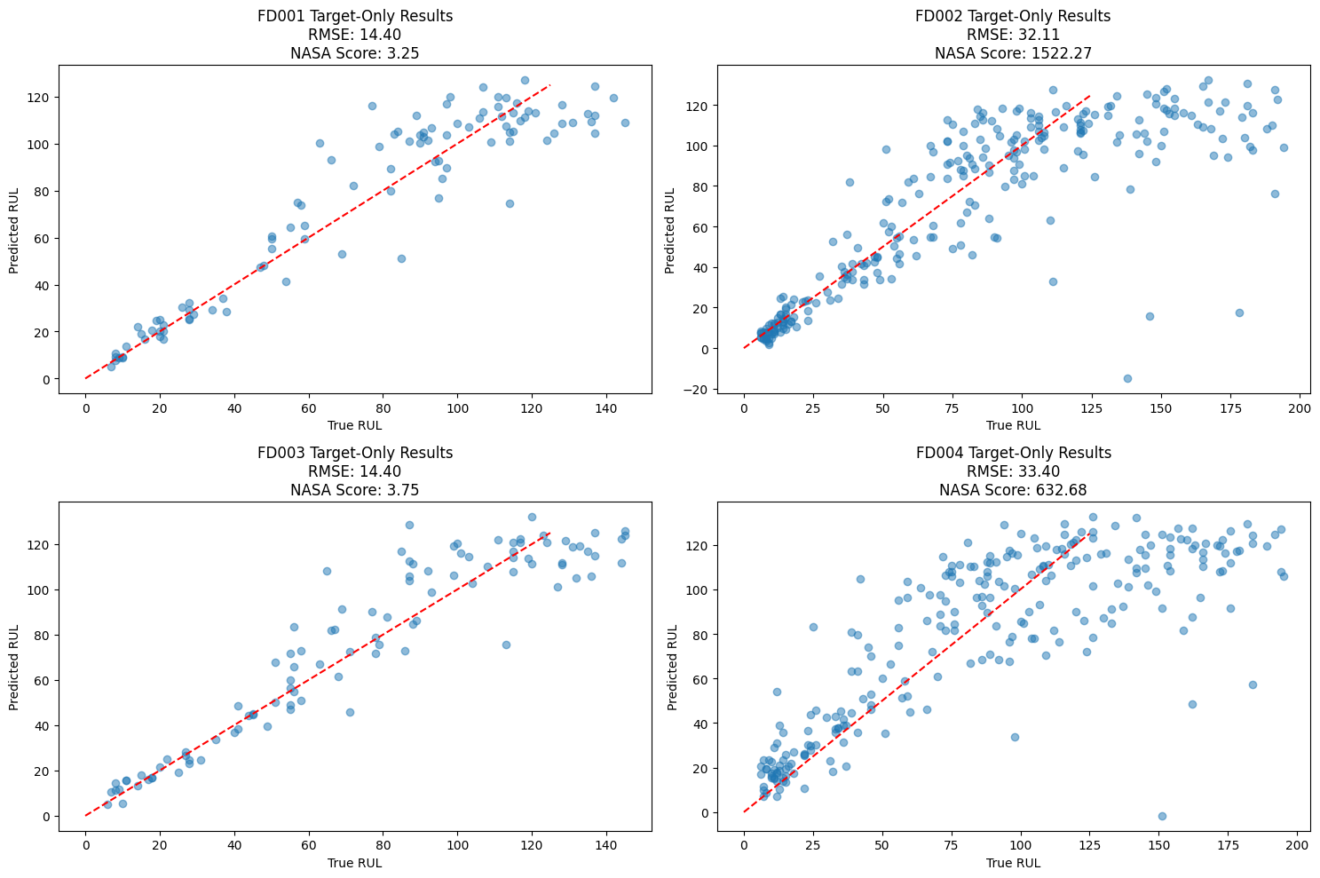
RESULTS
Same Domain using baseline LSTM
Source → Target | RMSE | NASA Score
FD001 → FD001 | 14.403 | 3.2
FD002 → FD002 | 32.115 | 1522.3
FD003 → FD003 | 14.399 | 3.8
FD004 → FD004 | 33.401 | 632.7
Notes:
Key Takeaways from Same-Domain Baseline
Best Cases (FD001 & FD003):
RMSE ≈ 15 cycles, NASA Score < 5
These datasets each have just one operating condition—so the LSTM quickly learns consistent wear patterns.
Moderate Case (FD002):
RMSE jumps to ≈ 31 cycles, NASA Score ≈ 193
Introducing six different operating conditions—even with only one fault mode—makes it harder for the model to capture every regime.
Hardest Case (FD004):
RMSE ≈ 35 cycles, NASA Score ≈ 669
Two fault modes + six operating conditions compound the complexity, pushing error higher.
few observations when interpreting those scatter plots:
Closeness to the diagonal: In FD001 and FD003, the blue points hug the red y=xy=xy=x line tightly, indicating the model’s predictions track the true RUL very closely across almost the entire range.
Spread & variance: FD002 and FD004 exhibit a much wider scatter around the diagonal—especially at higher true-RUL values—showing the model struggles to generalize across the multiple operating regimes in those datasets.
Systematic bias: For FD002 and FD004 you’ll notice many points lying above the line at high true-RUL, meaning the model tends to overestimate how long the engine has left, which directly drives up the asymmetric NASA penalty.
Error trends: All subplots show slightly larger deviations near the extremes (very low or very high RUL), suggesting the model finds the constant “healthy” plateau at the start and the steep final drop-off phases hardest to pin down.

Slide 9
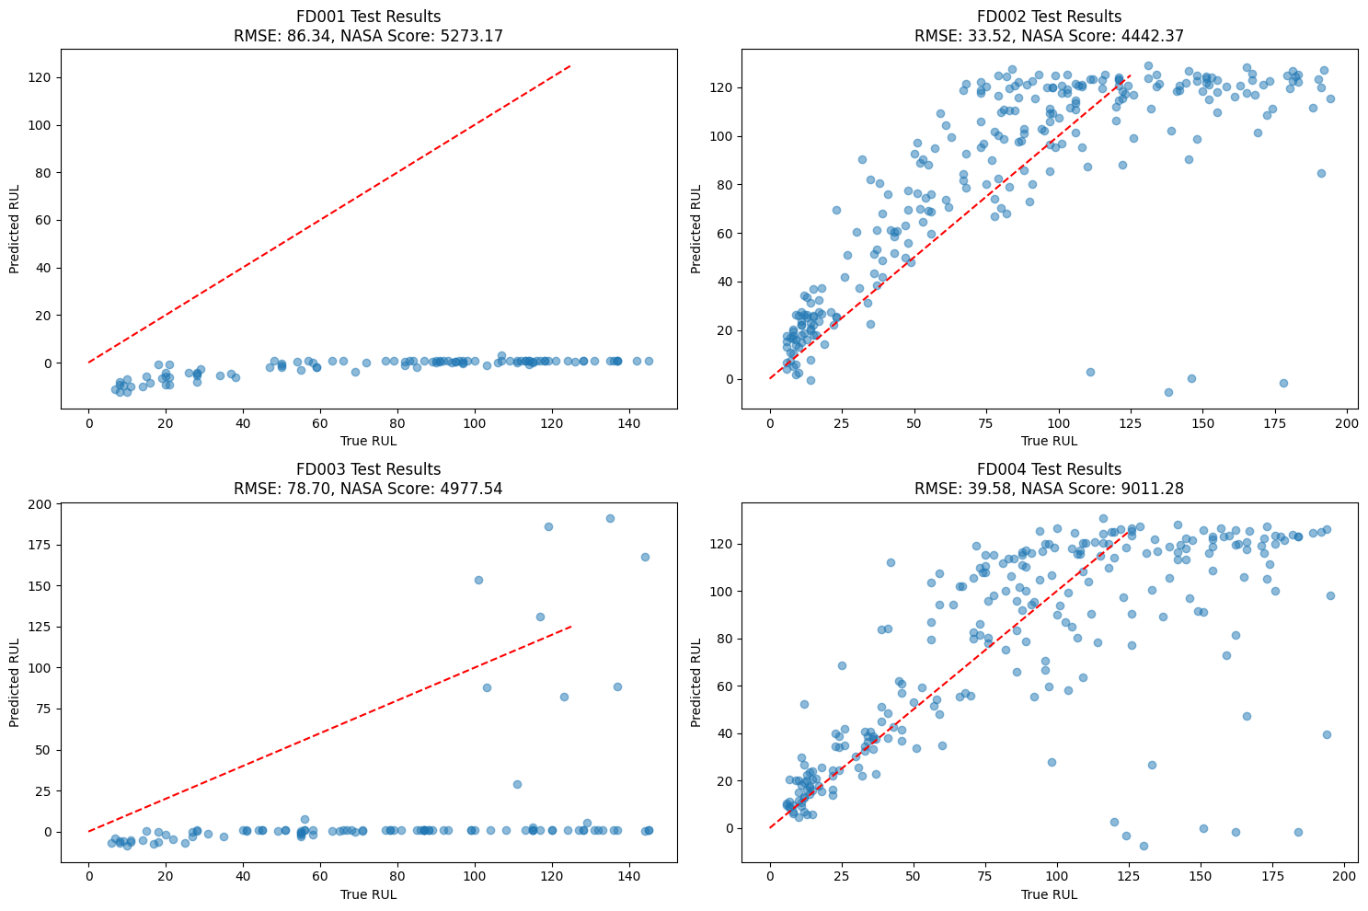
RESULTS
Cross Domain using Baseline
Source → Target | RMSE | NASA Score
FD004 → FD001 | 86.335 | 5,270
FD004 → FD002 | 33.516 | 4,440
FD004 → FD003 | 78.704 | 4,980
Notes:
Cross-Domain Baseline: Key Observations
Performance Varies Widely
FD004 → FD001:
RMSE ≈ 86.3 cycles—the worst transfer score—
NASA ≈ 5.3 × 10³. This massive drop reflects very different operating conditions and fault modes between FD004 (six conditions, two faults) and FD001 (one condition, one fault).
FD004 → FD002:
RMSE ≈ 33.5 cycles—the best of the three cross-domain tests—
NASA ≈ 4.4 × 10³. FD002 shares six operating conditions with FD004 (though only one fault mode), making it the most similar and the easiest to transfer to.
FD004 → FD003:
RMSE ≈ 78.7 cycles—second-worst transfer—
NASA ≈ 4.98 × 10³. Two fault modes are shared, but the single operating condition in FD003 still presents a gap.
All three cross-domain runs produce extremely high NASA penalties, indicating the model frequently over-predicts how much life remains—a dangerous bias in maintenance settings.
A simple “train-on-source, test-on-target” approach fails: RMSE swings by almost a factor of 3 from best to worst cases.
Clearly, naive transfer learning cannot bridge these domain gaps—operating condition mismatches and multiple failure modes overwhelm the LSTM.

Slide 10
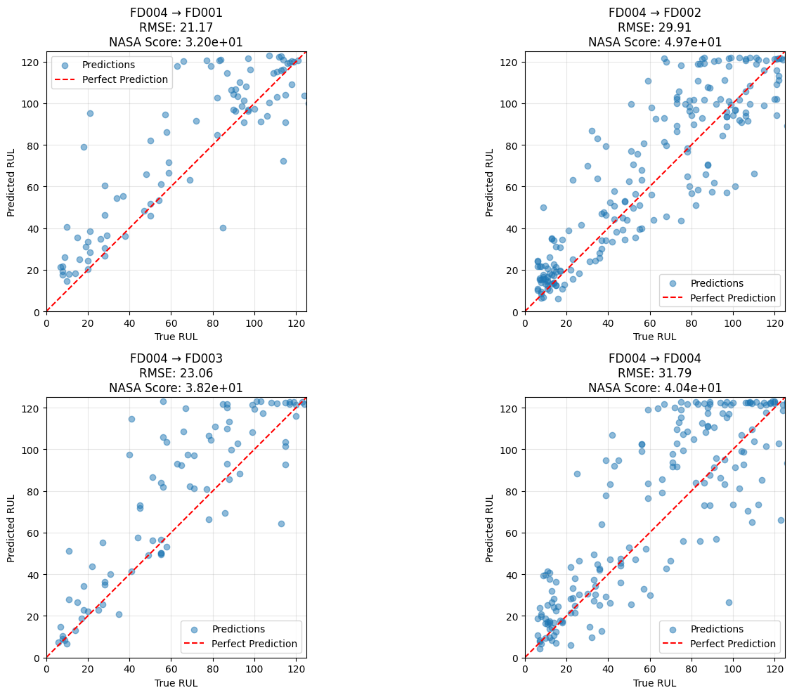
RESULTS
Cross Domain using LSTM DNN
Source → Target | Source-Only RMSE | DANN RMSE | NASA Score | Improvement
FD004 → FD001 | 86.335 | 21.171 | 32.0 | 75.5 %
FD004 → FD002 | 33.516 | 29.908 | 49.7 | 10.8 %
FD004 → FD003 | 78.704 | 23.061 | 38.2 | 70.7 %
Notes:
Key Observations from DANN Adaptation
Overall DANN Impact
Large RMSE Reductions: In two of three transfers, RMSE falls by over 70 %,
dropping from ∼80 cycles to ∼23 cycles.
Tighter Error Range: All three DANN runs now land between 21–30 cycles RMSE, rather than the wildly varying 33–86 range of the source‐only model.
Performance Stabilization: Adversarial alignment smooths out domain‐to‐domain differences, yielding more predictable accuracy.
Domain‐Specific Gains
FD004 → FD001:
75.5 % RMSE reduction (86 → 21 cycles) – the largest domain gap is almost completely closed.
FD004 → FD002:
10.8 % reduction (33 → 30 cycles) – this pair was already the most similar, so only a modest gain.
FD004 → FD003:
70.7 % reduction (79 → 23 cycles) – again, a dramatic correction when fault modes differed strongly.
Training Dynamics
Rapid Convergence: RMSE peaks above 70 in early epochs, then settles below 35 by epoch 25.
Minor Oscillation: Small RMSE bumps occur as the gradient reversal weight ramps up, but overall trend is steadily downward.

Slide 11
Questions?

